Slide 1

Blockchain course Beginning of Blockchain: History and the Bitcoin
Dr. Norbert Oláh

Slide 2

Table of Contents
Principles, dreams and motivations
Early history of Blockchain
The rise of Ethereum
Enterprise blockchain
Blockchain Community & Politics
Where are we now

Slide 3
PRE-BITCOIN: LIBERTARIAN DREAMS
Notes:
The ideologies that went behind the technology.

Slide 4
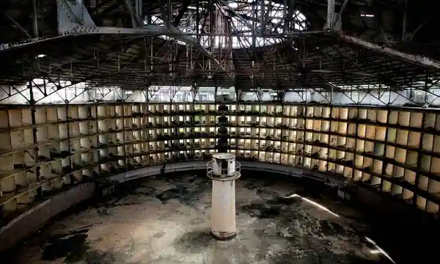
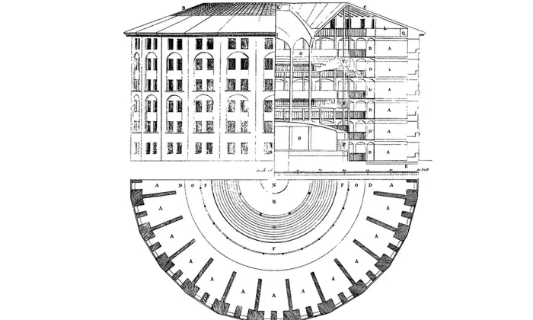
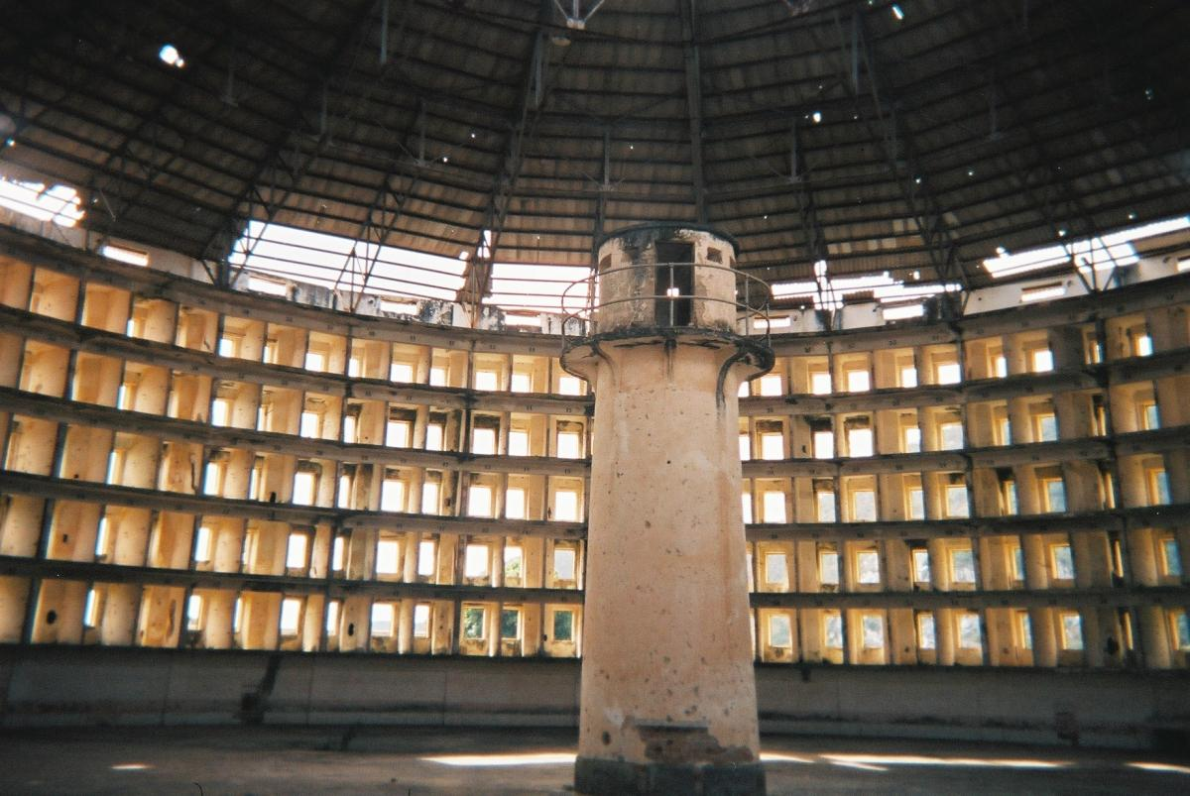
Pre-Bitcoin: Libertarian Dreams
Michel Foucault’s Panopticon
The Panopticon is constructed such that “the prisoner is seen without ever seeing and that the guards see everything without ever being seen.” As a result of constantly being watched, prisoners “change their own behavior—their paranoia becomes as effective a tool of control as actual surveillance. They become silent, docile, alienated.”
Notes:
https://www.theguardian.com/technology/2015/jul/23/panopticon-digital-surveillance-jeremy-bentham

Slide 5
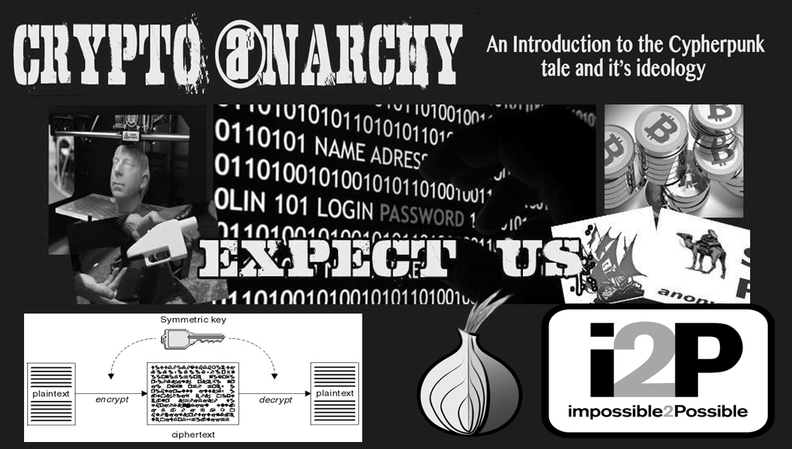
Pre-Bitcoin: Libertarian Dreams
Cypherpunks and Crypto Anarchists
Cypherpunks and Crypto-anarchists: libertarian groups concerned with privacy, and advocated cryptography as an important tool
“Privacy is the power to selectively reveal oneself to the world.”
“Privacy in an open society requires anonymous transaction systems.”
https://www.activism.net/cypherpunk/manifesto.html (1993)
Notes:
cypherpunks and crypto-anarchists
Group of cryptography-advocates with libertarian views
Eric Hughes wrote the Cypherpunk Manifesto: https://www.activism.net/cypherpunk/manifesto.html
Among other things, they felt that in this digital era - this “open society” - it’s important to have anonymous transaction systems instead of centralized banks
and they saw cryptography as a hugely important tool to help us maintain our privacy - which they define as the ability to selectively reveal your identity

Slide 6
Pre-Bitcoin: Libertarian Dreams
Cypherpunks and Crypto Anarchists
“Privacy is necessary for an open society in the electronic age. Privacy is not secrecy. A private matter is something one doesn’t want the whole world to know, but a secret matter is something one doesn’t want anybody to know. Privacy is the power to selectively reveal oneself to the world.”
A Cypherpunk Manifesto (Eric Hughes, 90s)
https://www.activism.net/cypherpunk/manifesto.html
Notes:
Group of people that were fed up with the large corporations and institutions having so much control over their data and eliminating their right to privacy, taking away their monetary power,
The Manifesto emphasized autonomy
Free flow of information is essential for the maintenance of rights

Slide 7
Cypherpunk dream
The government is corrupt and central systems do not provide the levels of trust that a society needs.
The society can start its own virtual one on a blockchain that is driven by decentralized consensus and transparency
Algocracy: computer algorithms maintain, control, and automate public services. (combined with AI)
“Blockcracy”: government by blockchain, after the vision of a blockchain
Notes:
an alternative form of governance and social system where computer algorithms maintain, control, and automate public services such as law, legal system, regulation, governance, economics, policies, and public decision-making.
Blockchain and DApps are well-suited means to enable algocracy, especially when combined with AI. Initially, AI (or even traditionally programmed software) was seen to allow algorithmic governance; now, blockchain combined with AI can offer a more elegant approach. However, there are both opportunities and threats associated with Algocracy. Increasing reliance on governance by algorithms is seen as a threat to active human participation and real-life decision- making. This is true in traditional algocracy without blockchain. However, when combined with blockchain, the situation improves. Due to the blockchain’s decentralized and community-governed model, governance algorithms are also subject to approval and scrutiny by the community (society) operating on the blockchain. Therefore, blockchain can be seen as a solution to this threat of losing control of the decision-making process.

Slide 8
History of blockchain

Slide 9
A few dry facts - History of blockchain
1970s - Cryptographic hash functions
1976 - Diffie–Hellman work on securely exchanging cryptographic keys
1977 - The invention of public key (asymmetric) cryptography – RSA
1979 - Invention of Merkle Trees (hashes in a tree structure) by Ralph C. Merkle
1982 - Blind signatures proposed by David Chaum
1982 - The Byzantine Generals Problem

Slide 10
A few dry facts - History of blockchain
1991 - Haber and Stornetta work on tamper proofing document timestamps. This can be considered the earliest idea of a chain of blocks or hash chains
1992 - Cynthia Dwork and Moni Naor publish Pricing via Processing or Combatting Junk Mail. This is considered the first use of Proof of Work (PoW)
2002 - The appearance of Hashcash by Adam Back
2004 - Development of B-Money by Wei Dei using hashcash
2009 - Bitcoin (first blockchain)

Slide 11
A few dry facts - History of blockchain
2010 - First real transaction with Bitcoin (Laszlo Hanyecz pizza order)
2014 - Ethereum Foundation and the use of blockchain technology beyond cryptocurrencies.
2015 - The Ethereum Frontier network was launched, allowing developers to write smart contracts and decentralised applications that could be deployed on a live network.
2015 - The Linux Foundation has launched the Hyperledger project
2016 - DAO incident, a bug in the Ethereum code was exploited, leading to a hard fork of the Ethereum network

Slide 12
A few dry facts - History of blockchain
2017 - Japan has recognised bitcoin as legal tender. About 15% of global banks have used some form of blockchain technology
2018 - Baidu has unveiled its blockchain-as-a-service platform
2019 - Walmart has launched its supply chain system based on the Hyperledger platform.
2019 - Amazon has announced the general availability of its Amazon Managed Blockchain service on AWS
2020 - Nearly 40% of respondents have integrated blockchain into production, and 55% consider blockchain a top strategic priority, according to Deloitte's 2020 Global Blockchain Survey.

Slide 13
A few dry facts - History of blockchain
2020 - Ethereum launched the Beacon Chain in preparation for Ethereum 2.0.
2020 - Stable coins have seen a significant rise as they promise greater stability than traditional cryptocurrencies
2020 - There is growing interest in combining blockchain and artificial intelligence to optimize business processes.
2022 - Ethereum has switched from Proof of Work (PoW) to Proof of Stake(PoS) consensus mechanism. The original Ethereum mainnet has merged with the Beacon Chain, which uses Proof-of-Stake. It now exists in a chain. Ethereum's power consumption has been reduced by ~99.95%.

Slide 14
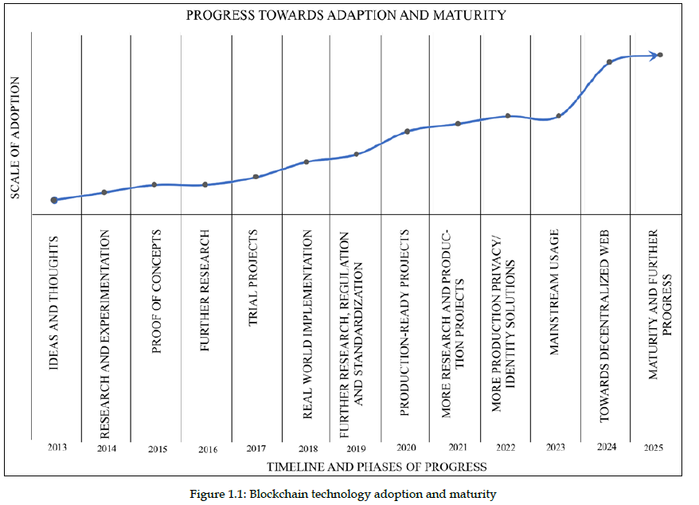
Notes:
[2] The following graph shows a broad-spectrum outline of the year-wise progression and adoption trends of blockchain technology
Mondanivalóm: Az abrá a blokklánc technológia éves fejlődését mutatja be. Folyamatos kutatások és megvalósítási területek, technikák figyelhetőek meg benne egész az indulásától, napjainkig. Ezentúl future planst is tartalmaz.

Slide 15
The challenges of cryptocurrency

Slide 16
The challenges of cryptocurrency
Expectations of cryptocurrency
Anonymity
Privacy issues: tracing and logging mechanisms
Accountability
Double spending problem
SMR problem
fault-tolerant service by replicating data
Decentralization
completely trustless or permissionless environment.

Slide 17
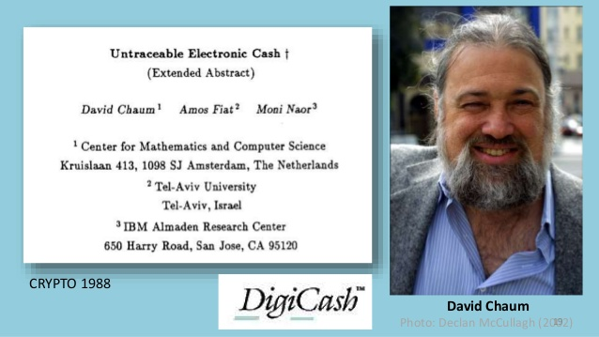
The challenges of cryptocurrency
The challenges of cryptocurrency – Anonimity issue
DigiCash: “Blind signatures” public key cryptography
David Chaum’s company
Allowed users to sign off on transactions without revealing anything about their identity
Failed due to centralization
Notes:
they didn’t just say aite let’s make a cryptocurrency and succeed the first try
digicash: so this really smart cryptographer named david chaum (og crypto wizard) invented ecash, which uses a “blind signature scheme” where you can have a public and private key, sign off on transactions without revealing anything about your identity, but be able to consistently use your private key and stay pseudonymous
centralization is a problem because of trust, transaction fees, security - everything was run by David Chaum’s company
that’s why people started looking into making a decentralized currency

Slide 18



The challenges of cryptocurrency
Blind Signature
Validation Authority
finalise the document
put it in an opaque indigo envelope
close the envelope and send it for signature
sign the closed envelope and return it to the sender
takes the document out of the envelope
the signature can be verified
The Validation Authority signs the document without knowing its content.

Slide 19
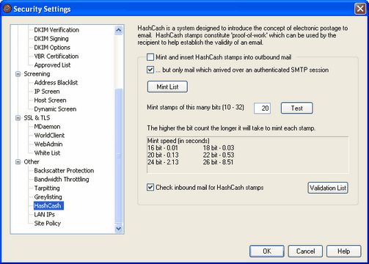
The challenges of cryptocurrency
Accountability & Double spending - HashCash
HashCash: Coins are minted by expending resources instead of by a central bank
Solve puzzle using a cryptographic hash function
Originally designed as a mechanism to limit email spam
The idea : 1997
"Hashcash - A Denial of Service Counter-Measure" 2002.
Notes:
Hashcash is a cryptographic hash-based proof-of-work algorithm, stamp is added to the header of an email
For email uses, the sender has taken a certain amount of time to generate the stamp and send the email, it is unlikely that they are a spammer.
The header contains the recipient's email address and date -> that a different header be computed for each recipient.
hashcash addressed the problem that, in a digital world where you can copy-paste anything you need a central bank to issue money in order to make it scarce and trustworthy
they said ok let’s make it so that you have to expend resources and a certain amount of time has to pass before you can mint more money - what does this sound like?
the cryptographic hash function

Slide 20

Pre-Bitcoin: Libertarian Dreams
Decentralization & SMR problem: B-Money
B-MONEY: Introduced two protocols
anonymous, distributed electronic cash system - 1998
Practical way to enforce contractual agreements between anonymous actors
Protocol in which every participant maintains an individual database of how much money belongs to each user
Notes:
anonymous, distributed electronic cash system
a proof of work function is proposed as a means of creating money, possible applications of Hashcash
In B-Money, money is transferred by broadcasting the transaction to all participants, all of whom keep accounts of all others.
“How we can solidify the transaction between them?”
Ensuring the integrity of how much funds are allocated per individual

Slide 21
Mix of all attempts

Slide 22

BITCOIN OVERVIEW
Satoshi Nakamoto and the Bitcoin
Anonymous creator of Bitcoin whitepaper: “electronic payment system based on cryptographic proof instead of trust.”
Bitcoin Whitepaper
2008 Launch
Proof of Work
Notes:
this person, who goes by the pseudonym satoshi nakamotowrites a paper called bitcoin: a peer to peer electronic cash system
he echoes a lot of the language used by cypherpunks around the need for anonymous transaction systems and says, ok in this electronic age we need trust otherwise our transactions can be compromised, but instead of trust let’s rely on cryptographic proofs
the big difference? successful decentralization, a consensus protocol for deciding on anonymous transactions
nobody cared about this paper when it was published, though, no faith the the fact that the majority of the network wouldn’t be malicious

Slide 23
Thank you for your attention!

